Slide 1
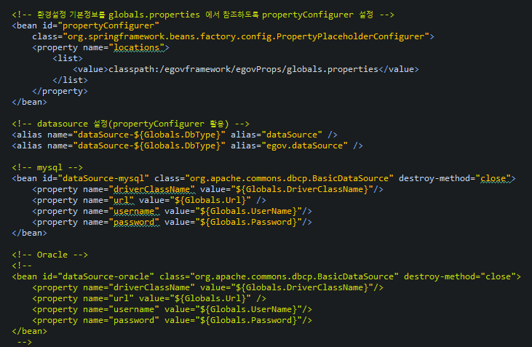
* context-datasource.xml
해당 부분만 빼고 다 삭제처리

Slide 2
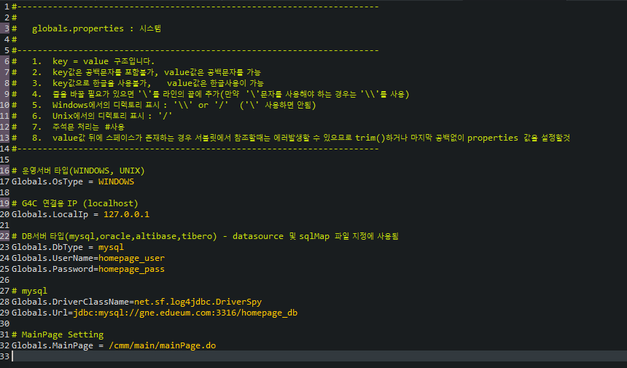
* globals.properties
127.0.0.1로 생성 및 그 외 내용 삭제하기

Slide 3
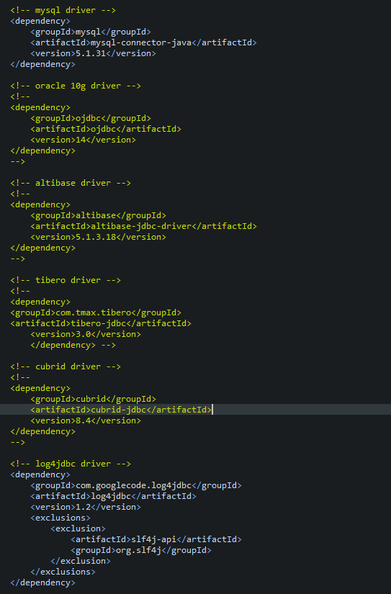
* pom.xml
해당부분 주석풀기
* 추가
<dependency>
<groupId>org.bgee.log4jdbc-log4j2</groupId>
<artifactId>log4jdbc-log4j2-jdbc4.1</artifactId>
<version>1.16</version>
</dependency>

Slide 4
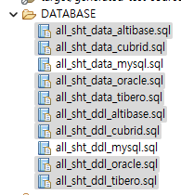
mysql 제외하고 나머지 삭제 후 DDL생성하고 데이터 집어넣기

Slide 5
* context.xml
<Resource name="jdbc/homepageDB" auth="Container" type="javax.sql.DataSource"
driverClassName="net.sf.log4jdbc.sql.jdbcapi.DriverSpy"
url="jdbc:log4jdbc:mariadb://dev2.dataeum.kr:3316/homepage2024_db"
username="homepage2024_user"
password="homepage_pass"/>
* context-datasource.xml
<bean id="dataSource-mysql" class="org.springframework.jndi.JndiObjectFactoryBean">
<property name="jndiName" value="java:comp/env/jdbc/homepageDB" />
</bean>

Slide 6

* context-datasource.xml
- JNDI 부분 주석처리하고 소스로 변경하기
* globals.properties
Globals.DriverClassName=net.sf.log4jdbc.sql.jdbcapi.DriverSpy
Globals.Url=jdbc:log4jdbc:mariadb://dev2.dataeum.kr:3316/homepage2024_db
해당 부분 수정

Slide 7

해당파일 전달

Slide 8
* pom.xml
* javax.xml.bind.JAXBException 에러용
<dependency>
<groupId>javax.xml.bind</groupId>
<artifactId>jaxb-api</artifactId>
<version>2.3.0</version>
</dependency>
<!-- Validator -->
<dependency>
<groupId>javax.validation</groupId>
<artifactId>validation-api</artifactId>
<version>1.1.0.Final</version>
</dependency>
<dependency>
<groupId>org.hibernate</groupId>
<artifactId>hibernate-validator</artifactId>
<version>5.2.4.Final</version>
</dependency>
<!-- mybatis log4jdbc-log4j2 라이브러리 -->
(3주차에 jdbc받았으면 제외)
<dependency>
<groupId>org.bgee.log4jdbc-log4j2</groupId>
<artifactId>log4jdbc-log4j2-jdbc4.1</artifactId>
<version>1.16</version>
</dependency>
<dependency>
<groupId>net.sf</groupId>
<artifactId>log4jdbc3</artifactId>
<version>1.1</version>
</dependency>

Slide 9
* log4j2.xml DEBUG모드로 변경
<Loggers>
<Logger name="java.sql" level="DEBUG" additivity="false">
<AppenderRef ref="console" />
</Logger>
<Logger name="egovframework" level="DEBUG" additivity="false">
<AppenderRef ref="console" />
</Logger>
<!-- log SQL with timing information, post execution -->
<Logger name="jdbc.sqltiming" level="DEBUG" additivity="false">
<AppenderRef ref="console" />
</Logger>
<Logger name="org.springframework" level="DEBUG" additivity="false">
<AppenderRef ref="console" />
</Logger>
<Root level="DEBUG">
<AppenderRef ref="console" />
</Root>
</Loggers>

Slide 10
-- 테이블 생성
CREATE TABLE LETTEMP
(
TEMP_ID INTEGER NOT NULL,
TEMP_VAL VARCHAR(100) NULL
);
ALTER TABLE LETTEMP
ADD PRIMARY KEY (TEMP_ID);
ALTER TABLE LETTEMP COMMENT = '임시데이터저장소';
ALTER TABLE LETTEMP CHANGE COLUMN TEMP_ID TEMP_ID INTEGER NOT NULL COMMENT '임시데이터ID';
ALTER TABLE LETTEMP CHANGE COLUMN TEMP_VAL TEMP_VAL VARCHAR(100) NULL COMMENT '임시데이터값';
ALTER TABLE LETTEMP
CHANGE TEMP_ID TEMP_ID INT(11) AUTO_INCREMENT NOT NULL COMMENT '임시데이터ID';

Slide 11
INSERT INTO lettemp(
TEMP_VAL
) VALUES (
'first'
)

Slide 12
int a = 1
자료형
변수명
값

Slide 13
INSERT INTO ids
(TABLE_NAME, NEXT_ID)
VALUES('TEMP_ID', 1);
<!-- TEMP START-->
<bean name="egovTempIdGnrService"
class="egovframework.rte.fdl.idgnr.impl.EgovTableIdGnrServiceImpl"
destroy-method="destroy">
<property name="dataSource" ref="egov.dataSource" />
<property name="strategy" ref="tempStrategy" />
<property name="blockSize" value="10"/>
<property name="table" value="IDS"/>
<property name="tableName" value="TEMP_ID"/>
</bean>
<bean name="tempStrategy"
class="egovframework.rte.fdl.idgnr.impl.strategy.EgovIdGnrStrategyImpl">
<property name="prefix" value="TEMP_" />
<property name="cipers" value="15" />
<property name="fillChar" value="0" />
</bean>
<!-- TEMP END-->

